Slide 1
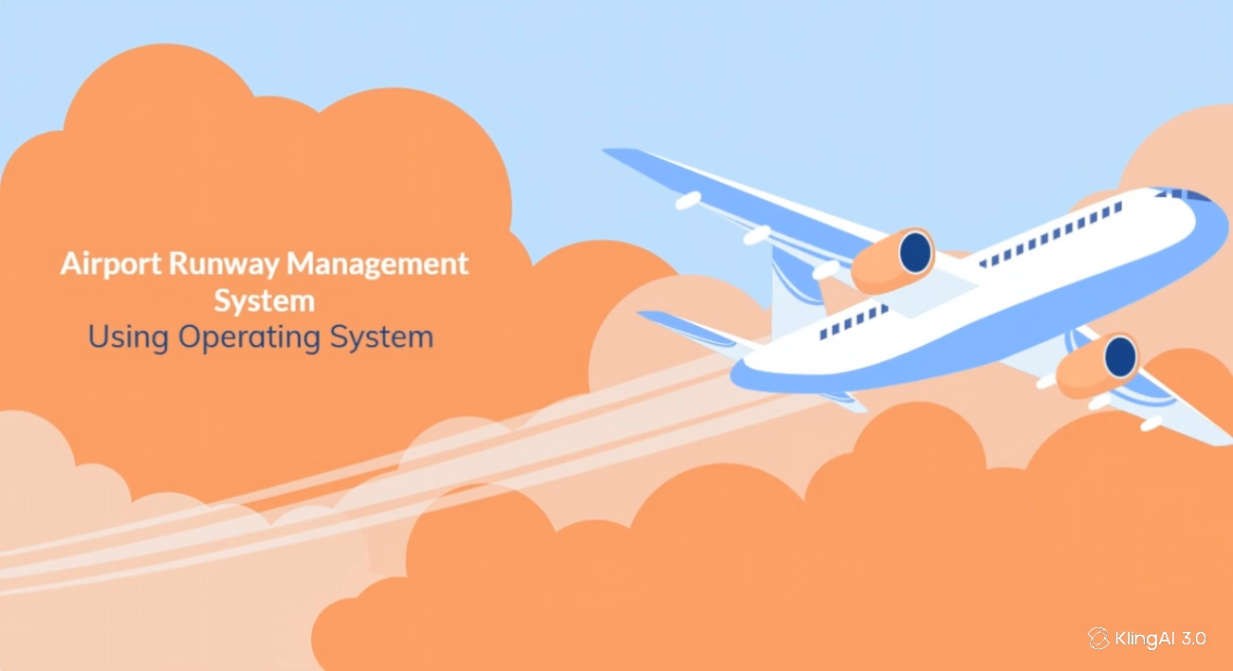

Slide 2
1
Project Overview
Our project simulates an airport runway system where multiple flights request runway access.
2
OS Concepts
We use threads, mutexes, semaphores, queues, and priority scheduling.
System Architecture & Scheduling
Flight threads send requests to queues, and the controller manages the runway.
3
Contents of this Presentation
Synchronization & Preventions
Mutexes prevent race conditions, while a semaphore ensures only one flight uses the runway.
4
Conclusion
The project demonstrates concurrency, synchronization, scheduling, and resource management in Operating Systems.
5

Slide 3
Project Overview
What is our project?
Simulates an airport runway management system.
Multiple flights can request:
Landing
Takeoff
Emergency access
Only one flight can use the runway at a time.
Uses OS concepts to safely manage concurrent requests.

Slide 4
Why is this system needed?
In a real airport, many aircraft may request runway access simultaneously.
Without proper coordination:
Multiple flights may try to use the runway.
Emergency flights may not get priority.
Landing and takeoff may conflict.
Race conditions may occur.
Runway resources may be allocated incorrectly.

Slide 5
OS Concepts Used
Concept | Use in Project
Multithreading | Each flight runs as a thread
Mutex | Protects shared queues
Semaphore | Controls runway access
Priority Scheduling | Emergency flights get priority
Queues | Store flight requests
Critical Section | Protect shared resources
These concepts directly demonstrate thread management, synchronization, resource allocation, and concurrent execution.

Slide 6
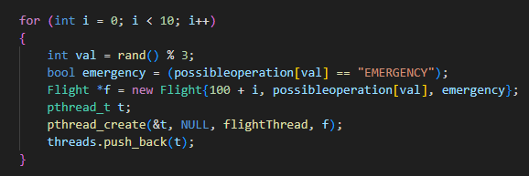
System Architecture & Scheduling
10 random flights.
Randomly assign Landing, Takeoff, or Emergency.
Create all flight threads concurrently.

Slide 7
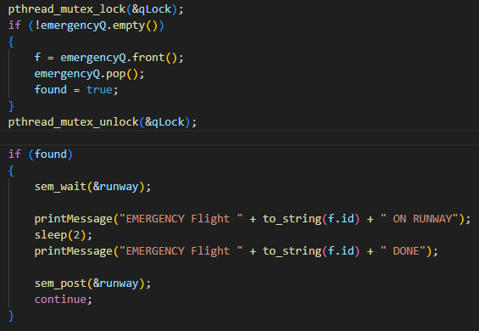
Priority Scheduling
1st Priority — Emergency: Emergency flights are handled first because they require immediate attention.
2nd Priority — Landing: After emergencies, normal landing requests are processed.
3rd Priority — Takeoff: Takeoff requests are processed after landing requests.
Runway Priority
Emergency > Landing > Takeoff

Slide 8
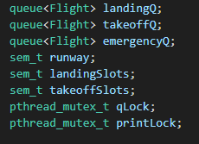
Synchronization & Preventions
How do we prevent conflicts?
Mutex
Protects landing queue.
Protects takeoff queue.
Protects emergency queue.
Prevents race conditions.
Semaphore
Controls runway access.
Runway semaphore = 1
Therefore, only one flight can use the runway at a time.

Slide 9
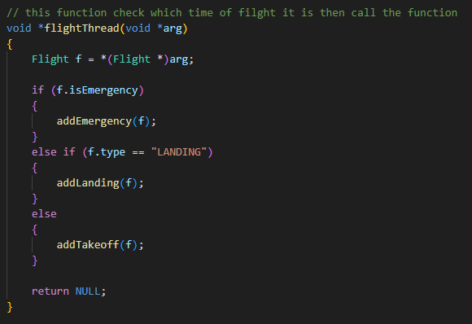
Main Threads & Functions
Flight Thread
Creates a flight request.
Determines flight type.
Adds it to the appropriate queue.
Terminates.

Slide 10
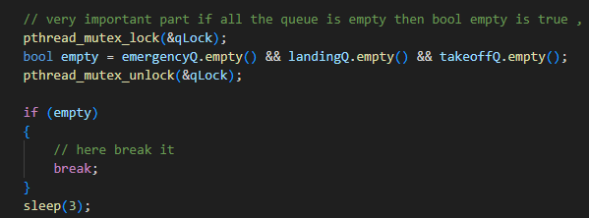
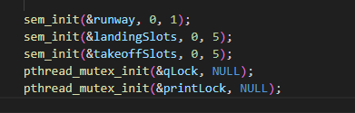
Controller Thread
Checks emergency queue.
Checks landing queue.
Checks takeoff queue.
Acquires runway.
Performs operation.
Releases runway.
Main Function
Initializes synchronization tools.
Creates threads.
Waits for threads.
Cleans up resources.

Slide 11
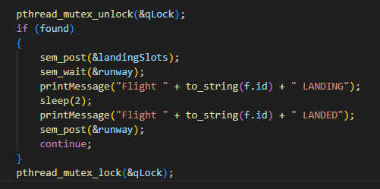
Deadlock Prevention
How did we reduce deadlock risk?
Use consistent locking.
Keep critical sections short.
Release queue mutex before waiting for runway.
Release runway after operation.
Avoid nested mutex locking.
Properly clean up synchronization resources.

Slide 12
Conclusion
Finally, our system uses separate flight and controller threads. We faced challenges such as race conditions, runway competition, queue overflow, and mixed console output. We solved these using mutexes and semaphores. Overall, this project helped us understand multithreading, synchronization, scheduling, and resource management in Operating Systems.

Slide 13
Thanks

Slide 14
Thanks

